Slide 1

Chapter 12
Communication Climate:
The Foundation of Personal
Relationships

Slide 2

Satisfying Personal Relationships
Self-Disclosure
Relational Dialectics
Confirming & Disconfirming Climates
Sustaining Healthy Climates

Slide 3
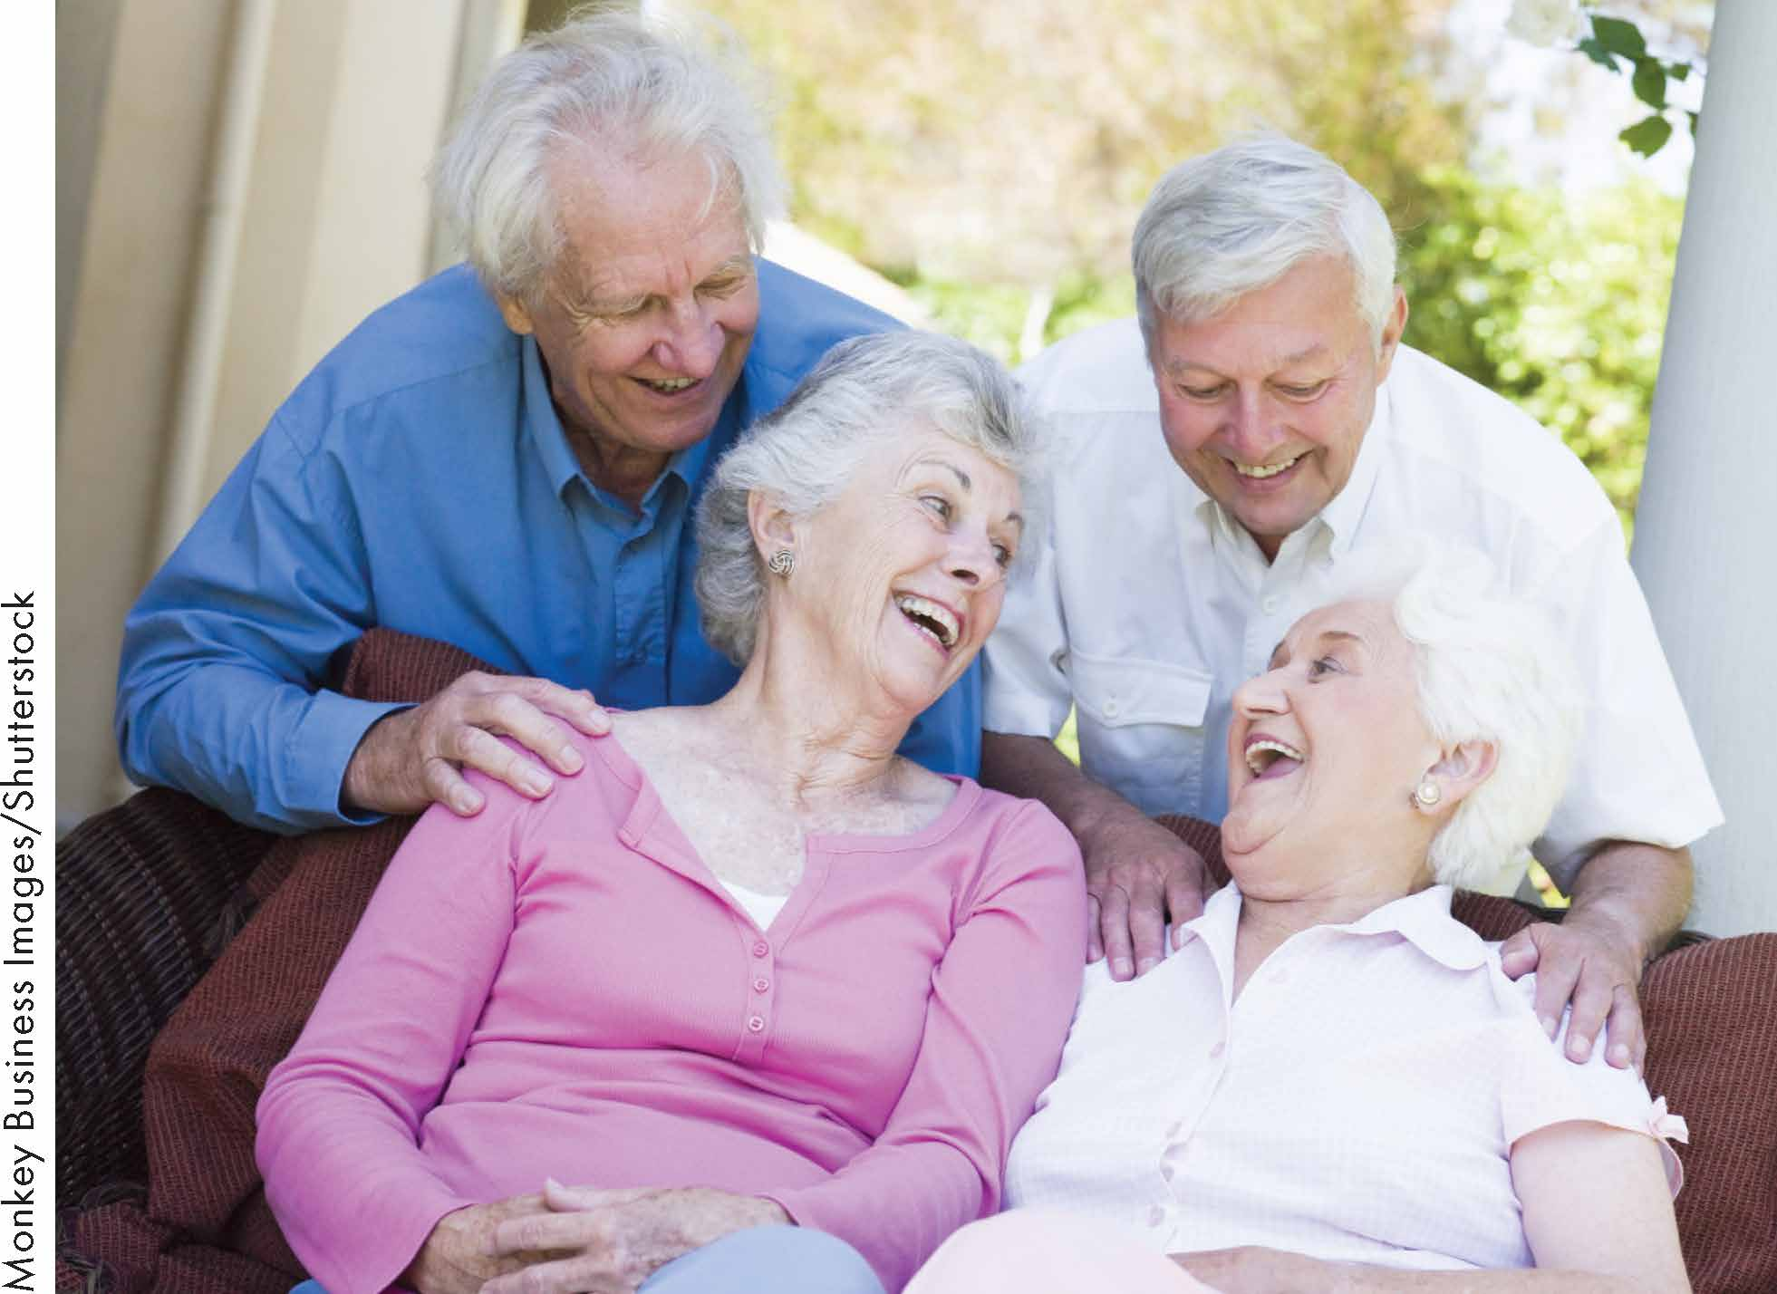
Interpersonal Climate
Interpersonal climate is the overall feeling or emotional mood between people

Slide 4

Features of Satisfying Personal Relationships
Investment
Commitment
Trust
Self-Disclosure
Comfort with Relational Dialectics

Slide 5
Self-Disclosure
The revelation of personal information about ourselves that others are unlikely to discover in other ways.
Appropriate
Reciprocal
Incremental

Slide 6
Self-Disclosure
Benefits
May increase trust
May enhance self-esteem
May increase security
May enhance self-growth
Risks
Rejection
Others may think less of us
Others may violate our confidences

Slide 7
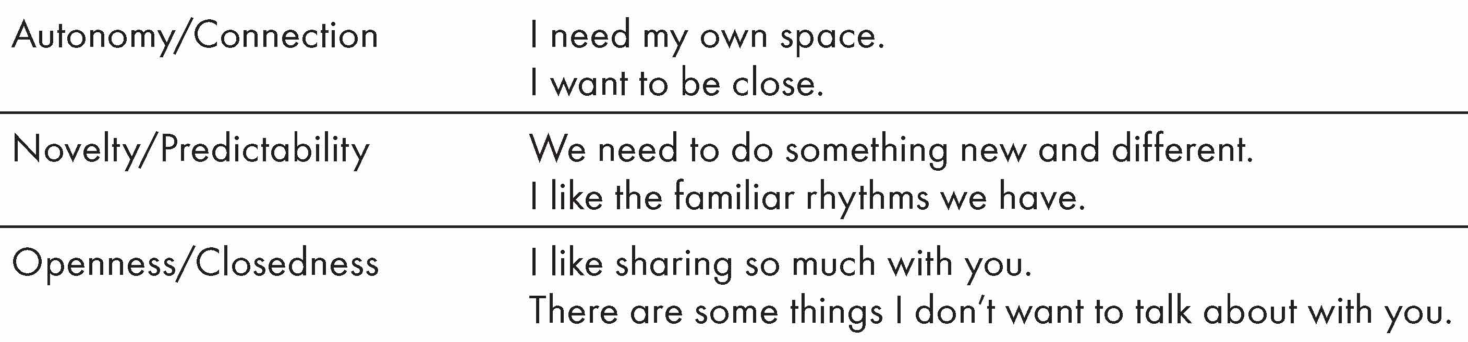
Relational Dialectics

Slide 8

Negotiating Dialectical Tensions
Neutralizing
Prioritizing
Separating
Reframing

Slide 9
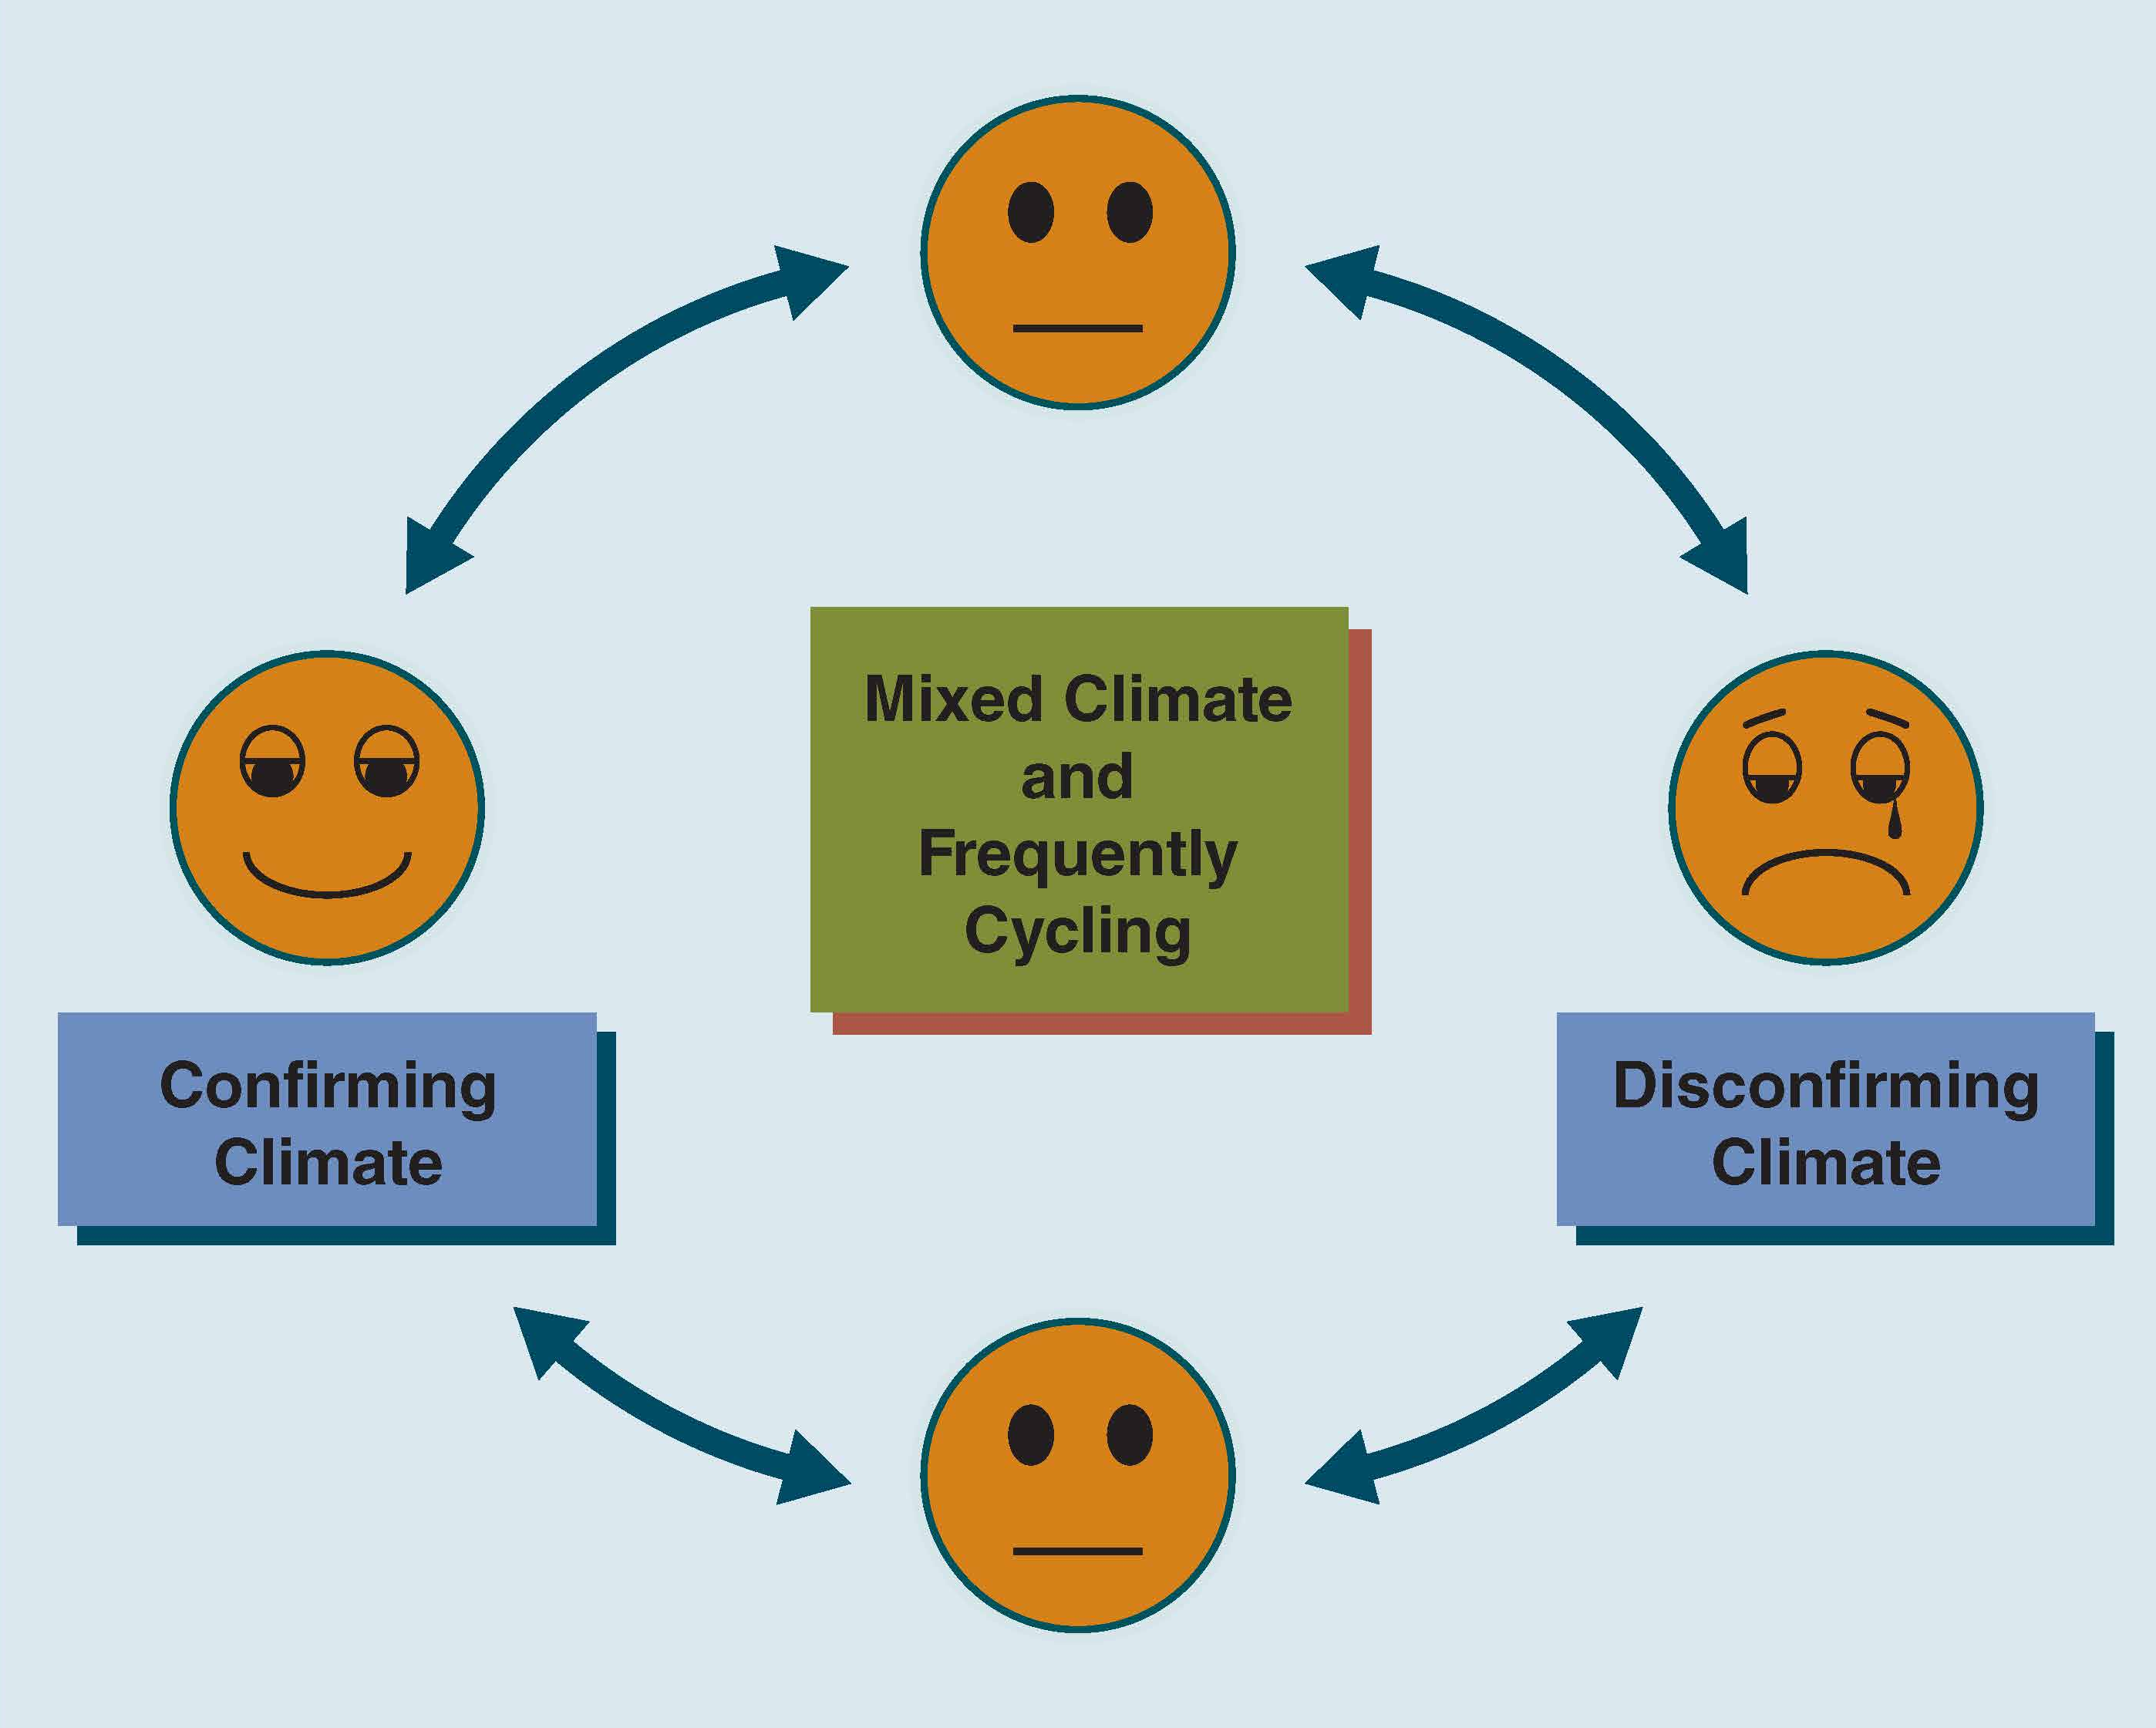
Confirming and Disconfirming Climates

Slide 10
Levels of Confirmation and Disconfirmation
Recognition
Acknowledgment
Endorsement

Slide 11
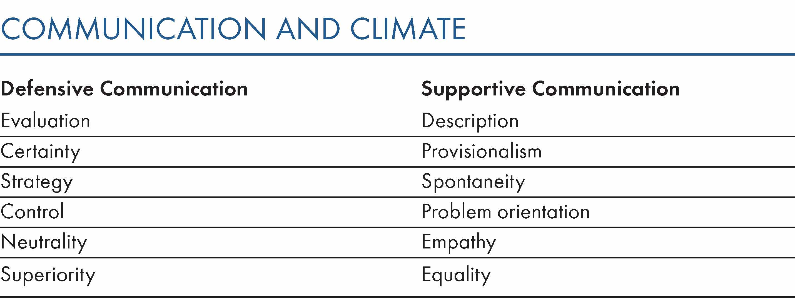
Defensive and Supportive Climates

Slide 12
Guidelines for Creating and Sustaining Healthy Climates
Actively Use Communication to Build Confirming Climates
Accept and Confirm Others
Affirm and Assert Yourself
Respect Diversity in Relationships
Respond Constructively to Criticism

Slide 13
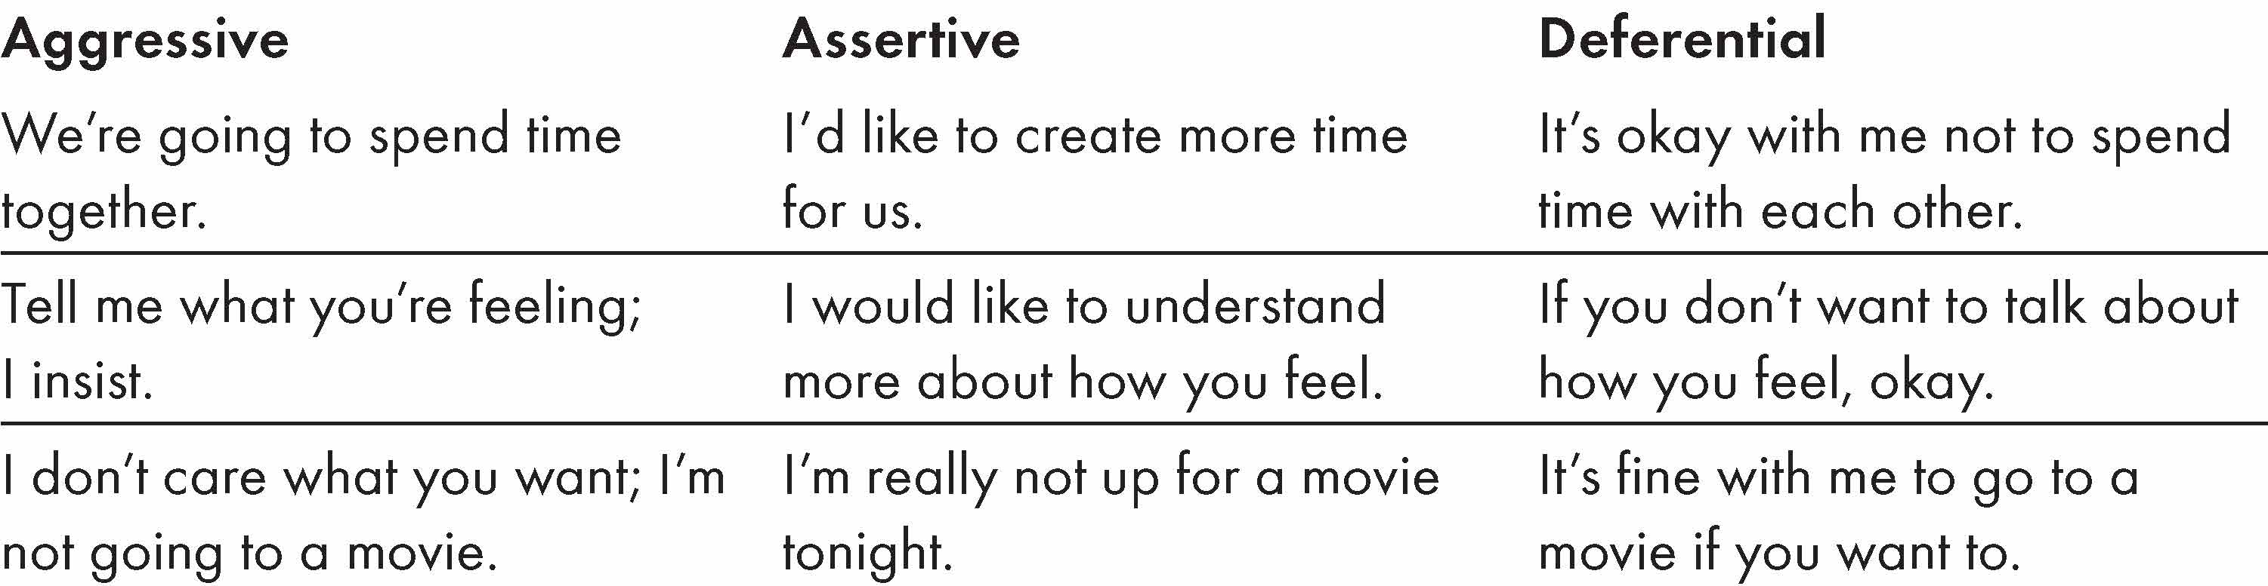
Aggression, Assertion, and Deference

Slide 14
Respond Constructively to Criticism
Seek Information
Valid
Change
No Change
Invalid
No Change

Slide 15
Summary
Interpersonal Climate
Supportive Climates
Relational
Dialectics
Chapter 12
Defensive Climates
Self-Disclosure
Disconfirming
Messages
Confirming Messages

